Slide 1
Angular 7 - Tutorial
1.Introduction

Slide 2
Prerequisite
HTML
CSS
Javascript
Basics of Typescript
Programming concepts (Variables, arrays, conditions. Loops, functions etc)

Slide 3
Introduction
Javascript Framework
Created and Maintained by Google
Front end application / Front end part of a full stack application
Written in Typescript
Angularjs(Not recommended) → Angular2 currently called as Angular.
Current version is Angular7 is having same framework with small changes

Slide 4
Why angular
Organized front end structure(Components, modules & Services)
Single Page application
A part of MEAN stack
Modular Approach
Re-Usable code
Unit testable
Develop across all platforms (Desktop, mobile, web)
Speed and Performance
Loved by millions

Slide 5
Angular History
2010 – Angular JS
2016 – Angular 2 (Currently called as Angular)
2016 Dec – Angular 4 (Angular 3 was skipped to avoid confusion due to misalignment of the router package)
2017 Nov – Angular 5
2018 Apr - Angular 6
2018 Oct – Angular 7

Slide 6
Development Environment
Node
Npm
Angular CLI
Text Editor – Visual Studio Code

Slide 7

Installation – Node, NPM, VSC
Install Node & NPM
https://nodejs.org/en/download/
Download and install based on your OS
Along with node js, npm(node package manager will also get install
Install Visual Studio Code Editor
https://code.visualstudio.com/download

Slide 8
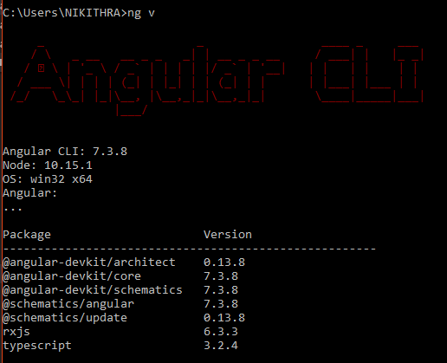
Installation – Angular CLI
Install Angular CLI
Angular CLI is the command line interface of Angular allows to generate building block of application by typing the commands
Helps development Quicker and easier all these with following best practices
Installation Cmd:
npm install –g @angular/cli

Slide 9
Chapter 1 : hello world
Your first typescript application

Slide 10
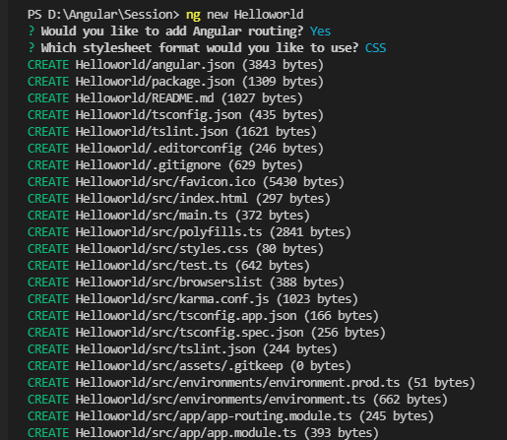
1.1 Hello world - Creation
Create Application
Terminal Output
Open Visual Studio Code and it has internal terminal to execute commands
Go to Terminal → Internal Terminal
In the terminal Enter the following command to create new Angular Project
ng new HelloWorld

Slide 11
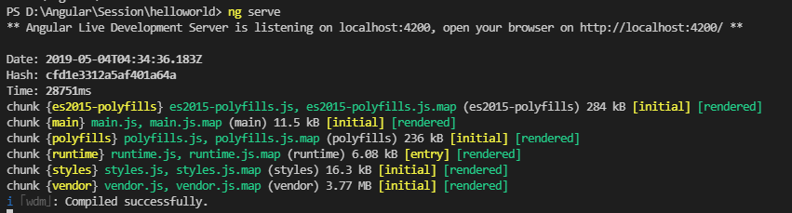
1.2 Hello world – Run and Terminal Output
Run Application
In Terminal navigate into application folder using cd cmd: cd HelloWorld
Now run the application using the cmd: ng serve
Terminal Output

Slide 12
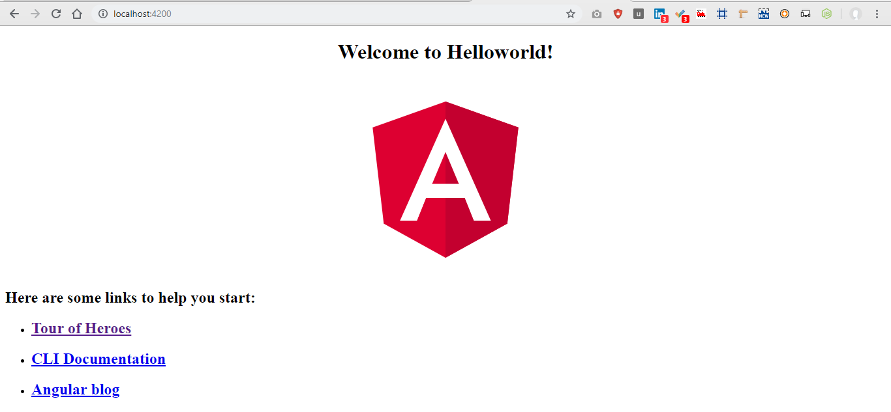
1.2 Hello world – Browser Output
Open Browser and type http://localhost:4200 which we get from terminal

Slide 13
Chapter 2 : Architecture
Modules
Components
Services

Slide 14
2.1 Modules
Modules are the first building block of Angular. Angular apps are modular in nature. Angular is a collection of individual modules.
Every modules represent a feature area in your application
User Modules : Contain all user related stuffs and Admin Modules: Contain all admin related stuffs
These modules can be imported or exported
Angular application should have minimum module which is called root module and here by convention we call it as APP Module
Each module is made up of Components & Services
Angular App
App Module
Module 1 (User Module)
Module 2 (Admin Module)
Import/export

Slide 15
2.2 Components
Components controls a portion of the view in the browser
For Eg: We can have components
1. Navigation Component
2. Side Bar Component
3. Main Content Component
An Angular app should have at least one component that is root component of the application which is conventionally called as AppComponent
All the component will be nested in root component
Every Component have
HTML template to display in browser
Class to control the component
Styles to styling the HTML
Angular App
AppComponent
Navigation Component
Side Bar Component
Contains HTML/CSS/Class

Slide 16
2.3 Services
A class that contains business logic of your application
AppModule
Navigation Component
App Component
Image Compression Service
Side Bar Component

Slide 17
Chapter 3 : File Structure
package.json - Dependencies & Scripts declarations
main.ts- Entry point of the application
Index.html
Style.css
Dist folder

Slide 18
3.1 package.json
File path: helloworld →package.json
Package.json contains Dependencies and DevDependencies(libraries and modules required for the application)
Packages listed here get installed when we run ng new helloworld command
All the packages get installed inside the node_modules packages
Also contains some scripts that can be executed
ng serve – runs our application
ng build
ng test
ng lint
ng e2e

Slide 19
3.2 main.ts
File path: helloworld →src→main.ts
Entry point of the application, compiles the application with just-in-time and bootstraps the application
Hammer.js is a small, standalone javascript-library that enables multitouch gestures like swipe, pinch, rotate, tap and drag on mobile devices
import 'hammerjs';
import { enableProdMode } from '@angular/core';
// The browser platform with a compiler // Used to bootstrap an Angular application
import { platformBrowserDynamic } from '@angular/platform-browser-dynamic';

Slide 20
3.2 main.ts
Call enableProdMode() to enable the production mode. Switching to production mode makes it run faster by disabling development specific checks such as the dual change detection cycles
import { AppModule } from './app/app.module';
// Enable the production mode
import { environment } from './environments/environment';
if (environment.production) { enableProdMode();}
The platformBrowserDynamic()indicates that we are boot Angular in a browser environment.
The bootstrapModule() function helps bootstrap our root module taking in the root module as.
// Compile and launch the module
platformBrowserDynamic().bootstrapModule(AppModule) .catch(err => console.error(err));

Slide 21
3.3 index.html, style.css, dist folder
Index.html
Filepath: Helloworld → src → index.html
This the first file which executes alongside main.ts when the page loads.
Style.css
Filepath: Helloworld → src → style.css
Global css which styles html throughout the application
Dist folder
Folder is where the built files are present.
TypeScript is basically converted to JavaScript and the resulting files are stored here after bundling and minification.
(This Folder appears only if the application is built)
Filepath: Helloworld →dist

Slide 22
Chapter 4 : App Module Files
app.module.ts
app.component.ts
app.component.html
app.component.css
app.component.spec.ts

Slide 23
4.1 app.module.ts
File path: helloworld →src→app→app.module.ts
AppModule is our root module which is the entry module for the application
In AppModule, we need to specify the component that will serve as the entry point component for the application.
We import the entry component (AppComponent) and supply it as the only item in our bootstrap array inside the NgModule configuration object.
This is the file where all the components, providers, and modules are defined
@NgModule({
declarations: [
AppComponent
],
imports: [
BrowserModule,
AppRoutingModule
],
providers: [],
bootstrap: [AppComponent]
})
export class AppModule { }

Slide 24
4.2 app.component.ts
File path: helloworld →src→app→app.component.ts
Import the Component class from @angular/core. Then we use it to decorate the AppComponent class which transforms it to a component.
The component decorator takes these information:
The selector contains the name of the tag that can be used to create this component.
The templateUrl contains the relative URL/path to the HTML template to be used as the view the styleUrls contains the array of CSS styles to be used for styling the component
import { Component } from '@angular/core';
@Component({
selector: 'app-root',
templateUrl: './app.component.html',
styleUrls: ['./app.component.css']
})
export class AppComponent {
title = 'Helloworld';
}

Slide 25
4.3 app.component.html
app.component.html
<h1>
Welcome to {{ title }}!
</h1>
File path: helloworld →src→app→app.component.html
Contains HTML Code for the component
app.component.css
File path: helloworld →src→app→app.component.css
Contains HTML Code for the component
h1 {
color: red;
}
app.component.spec.ts
File path: helloworld →src→app→app.component.spec.ts
Unit tests for this component

Slide 26
Chapter 5 : Application Flow

Slide 27


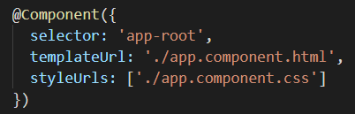

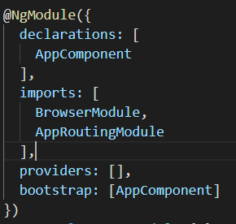
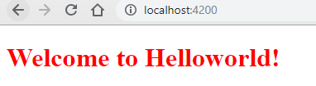


Application Flow
Browser
Common Files
App Module Files
Index.html
app.components.ts
http://localhost:4200
main.ts
Output
app.components.html
app.module.ts
app.components.css

Slide 28
Chapter 6 : Component
Component Architecture
Create Component
Import Component in Module
Use New Component
New Component Usage output
Inline Template
Inline style

Slide 29
6.1 Component Architecture
TEMPLATE
CLASS
META DATA
View
HTML
Code
Typescript
Data & Method
Information
Decorator @Component()

Slide 30
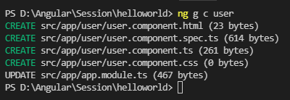
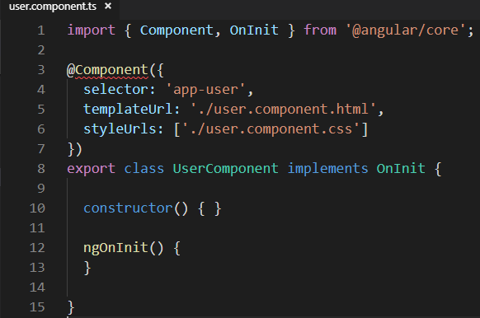
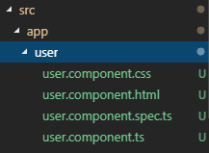
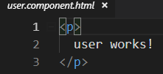
6.2 Create Component
Create Component command: ng generate component user or ng g c user

Slide 31
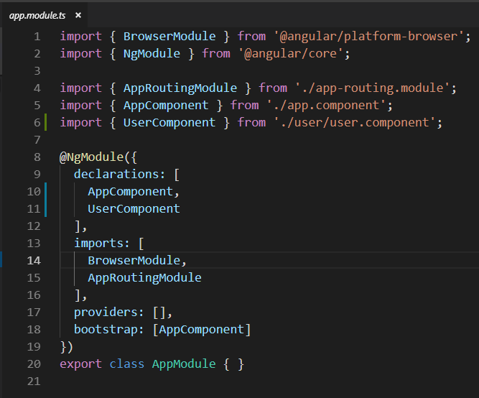
6.3 Import Component in Module
Application should be aware of the new Component, so import and bind the component in app.module.ts

Slide 32
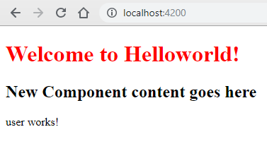
6.4 New Component Usage Output
In terminal run ng serve and in browser type http://localhost:4200

Slide 33
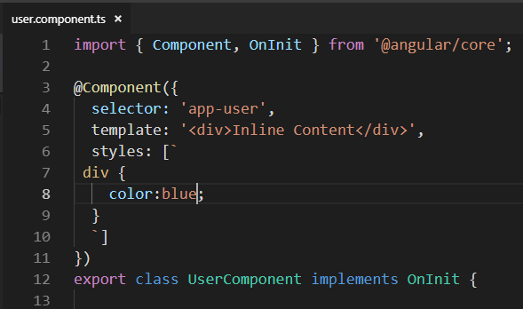
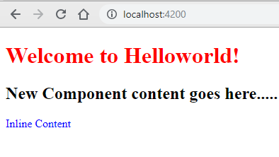
6.5 Inline Template
We can specify html element in component itself without referring to another resource
Change TemplateUrl to template
Change Resource name to desired html content inside colon

Slide 34
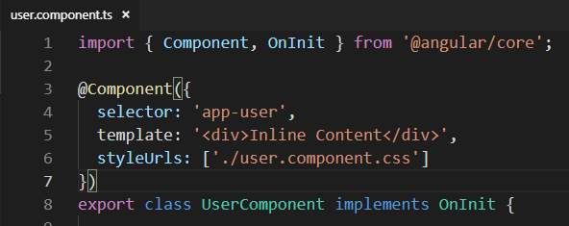
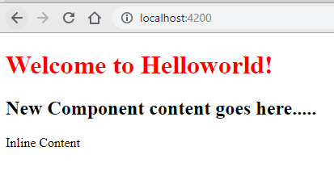
6.6 Inline Style
We can specify style element in component itself without referring to another resource
Change StyleUrl to Styles
Change Resource name to desired css content inside tilt colon

Slide 35
Chapter 7 : Interpolation {{}}
Pass data from component to template
Other features of Interpolation

Slide 36
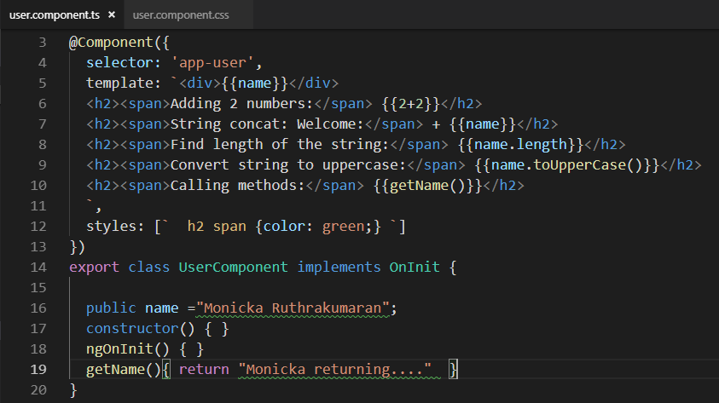
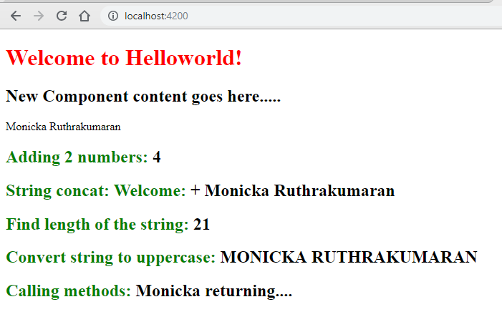
7.2 Other features of Interpolation
We can understand interpolation better in some other ways like performing calculation, string concat, find string length, use string methods
We also call methods from template using interpolation

Slide 37
Chapter 8 : Property Binding []
Attribute Vs Property
Understanding Attribute and property
Property Binding
Property Binding as Interpolation
Limitation in Interpolation

Slide 38
8.1 Attribute Vs Property
Attributes and Properties are the same
Attributes - HTML
Properties - DOM (Document Object Model)
Attributes initialize DOM properties and they are done
Attributes value cannot change once they are initialized
Property value however can change

Slide 39
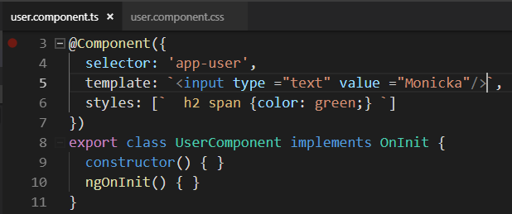
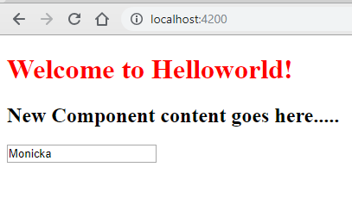
8.2 Understanding Attribute and property(1)
To understand attribute and property lets have a textbox and initialize with a value

Slide 40
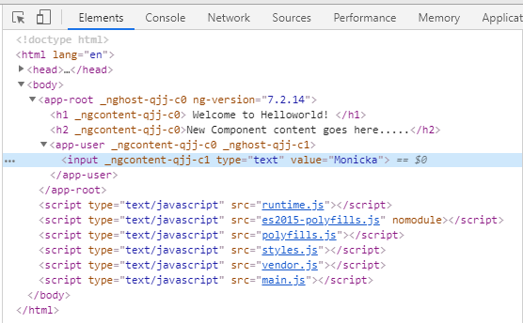
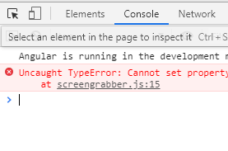
8.2 Understanding Attribute and property(2)
Open inspect element and select textbox tag
And navigate to Browser Console

Slide 41
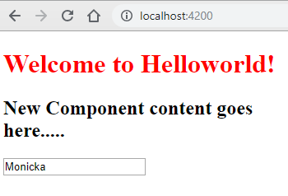
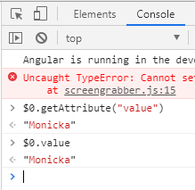
8.2 Understanding Attribute and property(3)
Execute the following commands in console
$0 refers current element
What Value the current component have
getAttribute means, what value assigned the attribute value

Slide 42
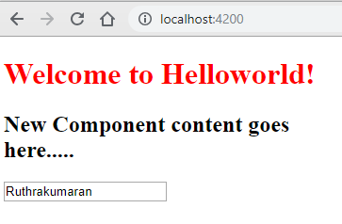
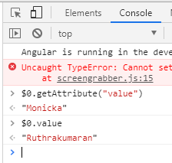
8.2 Understanding Attribute and property(4)
Change the value in the textbox and execute the same commands in console
What Value the current component have
getAttribute means, what value assigned the attribute value

Slide 43
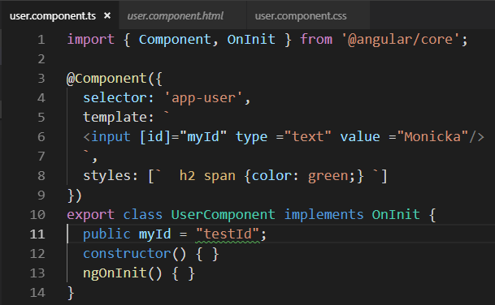
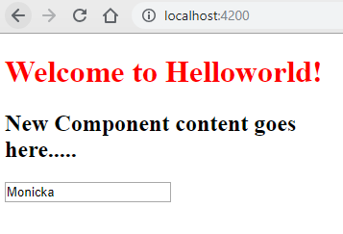
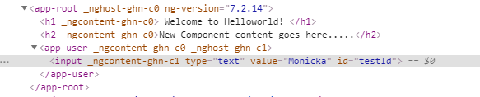
8.3 Property Binding
Create a property in component named myId holds value as testId
Bind the property myId to the ID attribute
And the ID gets the value of myId property as testId

Slide 44
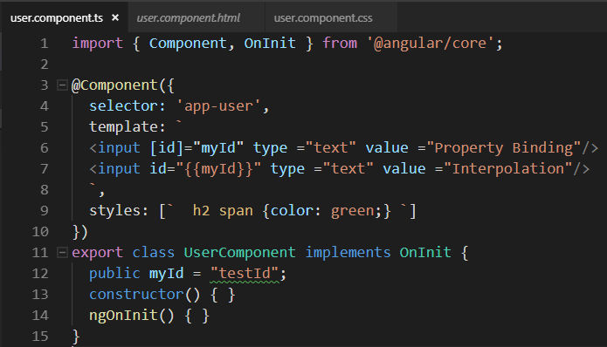
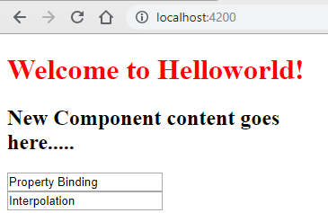

8.4 Property Binding [] as Interpolation{{}}
For String values property binding [] can also be done as Interpolation{{}}

Slide 45
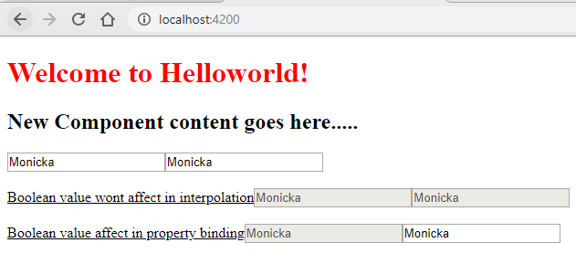
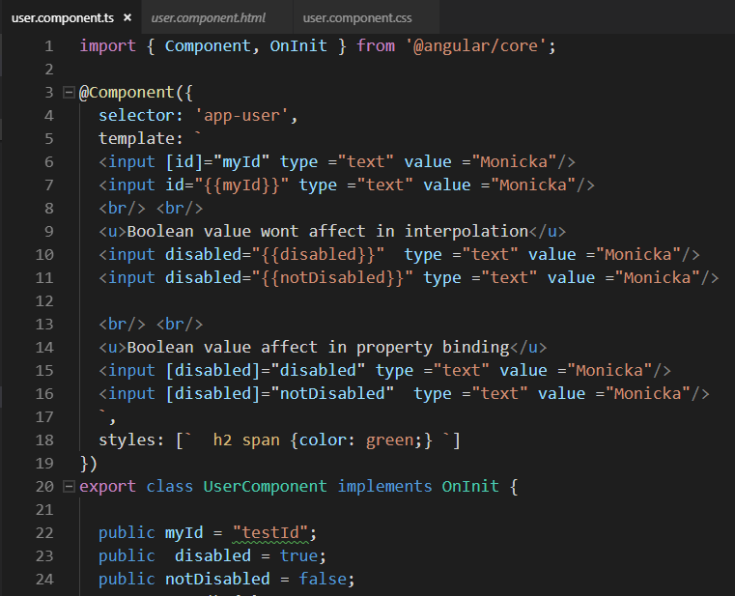
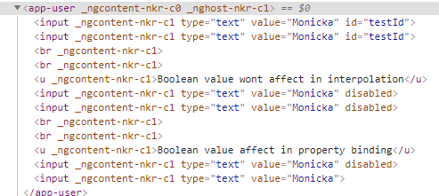
8.5 Limitations in Interpolation{{}}
For Boolean values Interpolation{{}} wont work

Slide 46
Chapter 9 : Class Binding [class]
Class Binding
Class Binding On conditions
NgClass – Custom Angular Class
Property Binding as Interpolation
Limitation in Interpolation
Template
Class
Class Binding
Data Binding

Slide 47
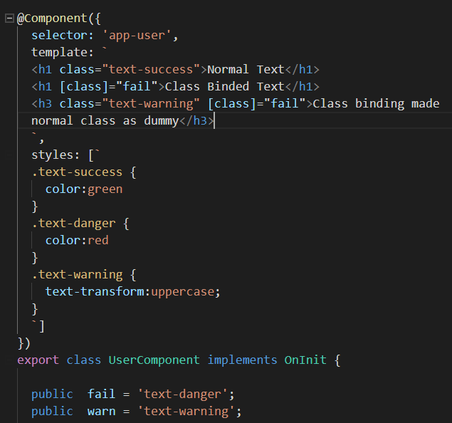
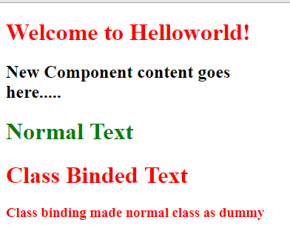
9.1 Class Binding [class]

Slide 48
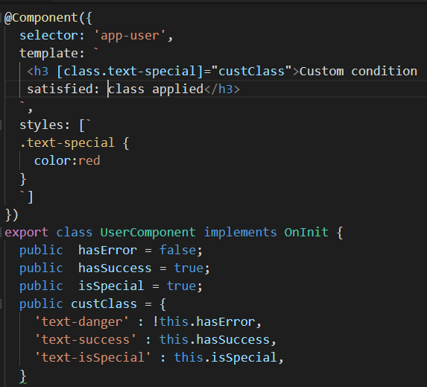
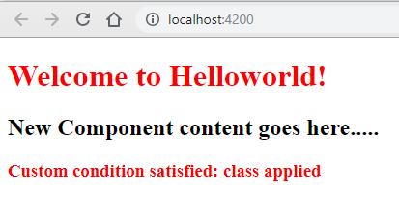
9.2 Class Binding On conditions [class.classname]=BooleanProperty

Slide 49
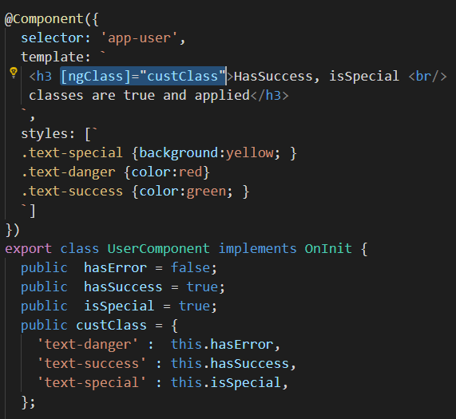
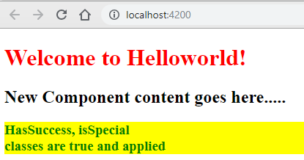
9.3 NgClass – Custom Angular Class [ngClass]="custClass"

Slide 50
Chapter 10 : Event Binding()
Data Binding Vs Event Binding
Event Binding : Example
Pass event as a parameter
Inline Click Event

Slide 51
10.1 Data Binding Vs Event Binding
Data Binding: Where the data flows from Component class to Component Template. Any changes in class property will get update in template too
Event Binding: Sometimes we have to bind user interaction like mouse event or Keyboard event then we have to keep data floe from template to class also called Event Binding
For event bind we need to bind a event function for the component. Like,
Click event for button
OnFocus for textbox
Mouse over for image
Event Binding
Template
Class
Data Binding

Slide 52
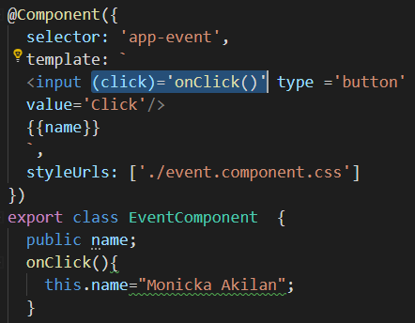
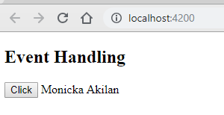
10.2 Event Binding : Example
Event Binding
Data Binding

Slide 53
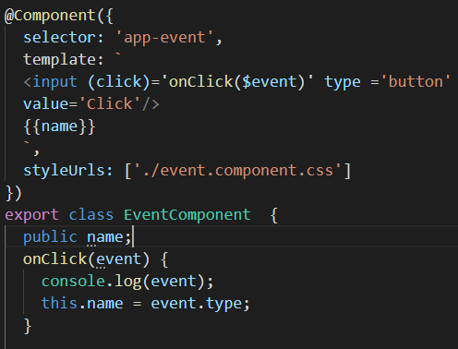
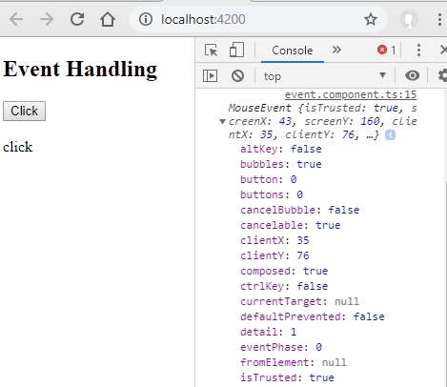
10.3 Pass event as a parameter

Slide 54
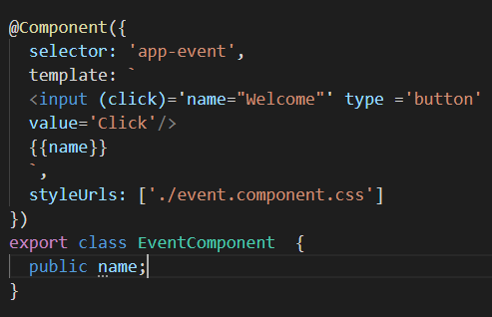
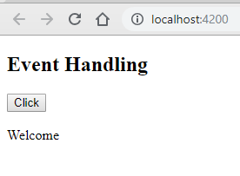
10.4 Inline Click Event

Slide 55
11.1 Template Reference Variable
A way to pass a data from template component and pass that vaue to class through a event handler property.
In the below example,
We are passing the value types in the boxed while clicking the button. So we are binding textbox and button using inputTxt and passing that to class through a even handler method OnClick and passing the textbox box value as parameter
<input #inputTxt type="text"/>
<input (click)='OnClick(inputTxt.value)' type ='button` value='Click'/>

Slide 56
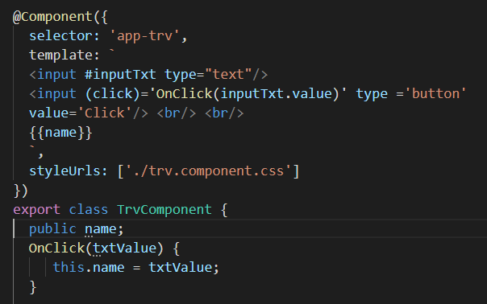
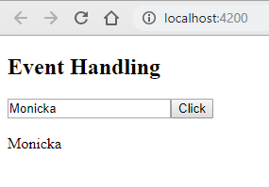
11.2 Template Reference Variable

Slide 57
12 : Two Way Binding
While working with model and view, its essential that the data is always in sync otherwise the data might not be in consistent
We have to import ngModel in appmodule.ts from @angular/forms pkg
Angular Directive for two way binding is [(ngModel)]=name
Event Binding
Username
Public Username Public Password
Two Way
Binding
Password
Data Binding

Slide 58
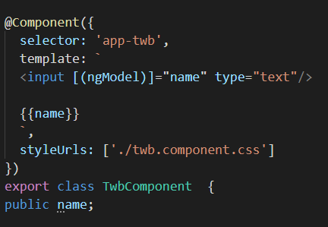


12 : Two Way Binding

Slide 59
13 : Structural Directives
Structural Directives are directives that let us add or remove HTML elements from the DOM
Common Built-In Structural Directives
ngIf – Conditionally Render HTML Element
ngSwitch - Conditionally Render HTML Element
ngFor – Render HTML elements in List

Slide 60


13.1 : ng-If (*ngIf)
Even though the show h2 is not visible in output but still its in DOM. This is entirely different from CSS Display property

Slide 61


13.2 : ng-If ; else

Slide 62


13.3 : ng-If ; then; else

Slide 63


13.4 : ng-switch

Slide 64


13.5 : ng-for

Slide 65
14 : Component Interaction @input(), @output()
So far we have a parent AppComponent and child TestComponent
In real time we will be in a situation to share data between two components
For this purpose we will use a tag @input(), @output()
Data @input()
name
Parent
Admin Component
Child
User Component
Success
Admin Component
Hello Monicka
User Component
Data @output()
Success

Slide 66



14.1 : Parent to Child Data Binding

Slide 67
14.2 : Child to Parent Data Binding
Parent component to child component data binding is easy, because we are having the child component selector in parent component. In that we can easy pass data.
But in child component we don’t have parent component tag so we cant do like that
We have to create a EventEmitter and emit it to parent component using the decorator @Output.
Create a event to trigger the Emitter like button click and then have to get the value in parent component like normal event binding
See example in next slide →

Slide 68




After Click Event

Slide 69


15 Pipes(1)
Pipes allow us to transform data before they display in the view
The Pipe operator will change only the format of the property in view which does not update the property value in class

Slide 70


15 Pipes(2)

Slide 71
16 Services
A class with a specific purpose
Share data across multiple components
To implement application logic
Can be used for External Interaction like DB Connect, Print etc…
Naming Convention .service.ts

Slide 72


16 Need Of Service
We have a requirement to display employee name from person object in EmployeeList Component. For that the code will be like below

Slide 73


16 Need Of Service
Now we have another requirement to display complete person details in employee-detail page. So for that how can we code….
Copy paste person object in Employee Detail Component and display details

Slide 74
16 Is it right way of doing……?
Do Not repeat yourself (DRY)
Here the same person object code is repeating in two components (Employee-list and Employee Details)
Single Responsibility Principle
Here the two components not only focusing on data depends on the view but also creating person job. This should be like this way.
Solution:
We have to create a service common to both component and place the person object creation code there and then the components will access that code and produce the output

Slide 75
17 : Dependency Injection
Problem without DI
DI as a Design Pattern
DI as a Framework

Slide 76


17.1 Problem without DI (1)
Lets take an example of creating a car which is only made up of Engine and tyre.
So we have 3 classes
1. Car, which has dependency of the following 2 classes
2. Engine
3. Tyre
Here To get Car object we are creating both Engine and Tyre in Car constructor meaning, if I want to create a car it will automatically create engine and tyre
So far no problem with the example…..

Slide 77


17.1 Problem without DI (2)
Now the requirement is changing and the engine constructor is getting a parameter
Now the class code has broken, because no parameter passed for Engine object creation inside car constructor.
Only possible way to solve this is we have to modify the code
As it’s a simple application its easy to maintain but what if the car 20 dependency and those have other dependency…
EOD code will be mess and out of Control
Solution for this problem is Dependency Injection

Slide 78


17.2 DI as a Design Pattern(1)
DI is a coding pattern in which a class receives its dependencies from external sources rather than creating them itself
In this car class we are passing car object as a parameter rather than creating inside constructor
So any modification in Engine object creation will not affect car object creation

Slide 79



17.2 DI as a Design Pattern(2)
Now after DI lets see how the changes in the dependency classes(Engine, Tyre) is not affecting the Car class
If the parameter is added or not the end result of Engine object is myEngine, by taking that object as parameter the car class will not get affected

Slide 80

17.2 DI as a Framework
Angular provides a special way to implement DI framework is Injector.
This Injector will have all the dependencies required for the car class, whenever we need a particular class the injector will give the dependency object

Slide 81
18. DI using a service (1)
Define the EmployeeService class
Register with injector
Declare with dependency in EmpList and EmpDetails
Employee Service
Injector
Employee List
Employee Data

Slide 82

18. DI using a service(2)
Define the EmployeeService class
Service creation syntax: ng g s employee
You will have Employee.service.ts inside app folder
Register with injector
Inject the employee service in app.module.ts. So that throughout the application this service can be used

Slide 83
18. DI using a service(3)
Add logic in EmployeeService class
Create a method in Employee Service class and move the person object creation code
Inject Service in Component
Inject employee service in Employee List Component Constructor
Make Employee list person object as null
Call employee service getEmployee method to assign value for person array

Slide 84





Slide 85
19 : HTTP and Observables
So far we have hardcoded values to display. But in real time scenarios we need to get those values from some server
For that we need to use HTTP and Observables this is returned by the HTTP call.
Usually the server have a database which contains all data and send back the desired output based on our requirement.
Lets see HTTP Mechanism…

Slide 86
19.1 : HTTP Mechanism
Get
Browser
Server
EmpList
DB
EmpService
Get
HTTP
Request
Observable
Response
EmpDetail

Slide 87

19.2 : Observables

Slide 88
19.2 : Observables Explanation
Newspaper Eg:
Angular Eg:
There is a source for all news which is a story
Newspaper company get that source and convert that in a format for viewers to read
They wont issue newspaper to all but only to those who subscribed for that newspaper
Once they issued the paper their responsibility got over and they don’t mind how the users using their paper
Its their own wish to use the newspaper either to read and to make kite
DB have data and that will be send to service through observables. It’s a single line async data
Service will format the data how the user want
Service will send the data o the component who are all subscribed to that request
Once the component got their data they can use how they want. Employee list use only name and employee detail use all data no issues in that

Slide 89
20 : Fetch data using HTTP
HTTP get request from EmpService
Receive the observable and cast it to an employee array
Subscribe to the observable from EmpList and EmpDetail
Assign the employee array to the local variable
RxJS
Reactive extension of Javascript
External library to work with Observable
npm install --save rxjs-compat
See Example in next page….

Slide 90



Slide 91


Check output by yours…..

Slide 92
21 : HTTP Error Handling
To inform the user if any error get occurs

Slide 93




Slide 94
22. Routing & Navigation
A way to navigate between views when the user performs a operation
Generate a project with routing option
Generate Department List and Employee List Component
Configure the routes
Add Buttons and use directives to navigate
Create a component with inline template and inline style
ng g c emp-list –it -is
See Example in next page….

Slide 95





Slide 96
23. Wildcard Route
We have configured two routes to access two components. What if the user typed a route which is not present. It will through an error.
For that we have to configure a page not found for this scenario
Generate a component as page-not-found
Add a new path in route array saying ** to Page not found component
We have to only modify the app.routing.ts
See Example in next page….

Slide 97



Slide 98
24. Redirect Route
This will be used to when a URL need to redirect to another URL
This contain a attribute called pathMatch. This holds value like
Prefix: This will redirect all the URL except defined to the redirected one. No ** path will work. That also will get redirect to given one
Full: This will redirect only the particular url to the redirected one.
See Example in next page….

Slide 99



Home page redirected to /dept-list
Undefined URL redirected to /page-not-found

Slide 100
25. Route Parameters
Department List
Department Detail
Angular
Node
MongoDB
Ruby
Bootstrap
You have selected Department with Id=2
You have selected Department with Id=4
See Example in next page….

